Slide 1
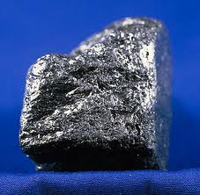
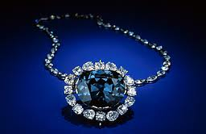
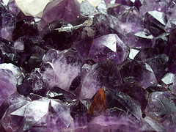
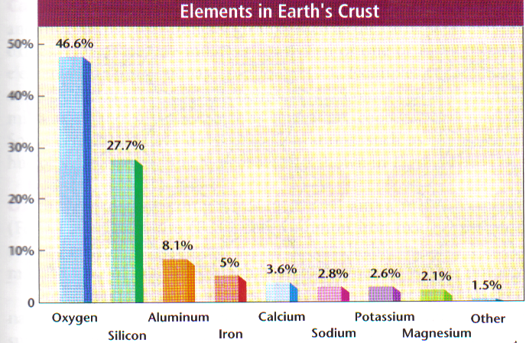
What is a Mineral? Sec 4.1
Earth’s crust is composed of about 99% minerals
These are all made from different combinations of the same 8 elements.
Mineral = A naturally occurring, inorganic, solid, with a specific chemical composition and a definite crystalline structure
Examples of minerals: graphite, quartz, copper, diamonds, rubies, sapphires

Slide 2
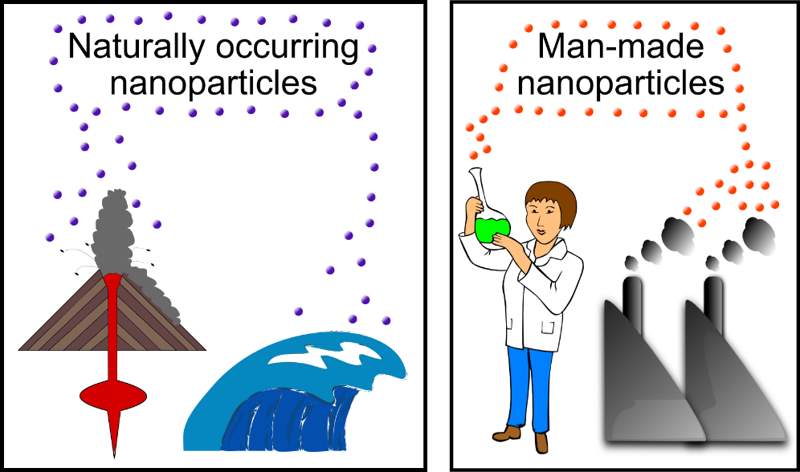
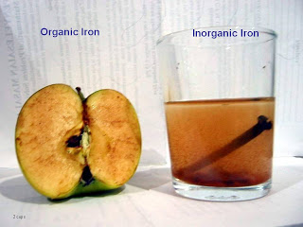
The 5 Common Mineral Characteristics Explained further
Naturally occurring
Minerals are formed by natural processes, NOT needing to be made in a lab
Inorganic means minerals are NOT a living organism and do NOT require a living organism to make them
Solid
http://sustainablenano.files.wordpress.com/2013/03/naturallyoccurringvsmanmadenanoparticles.png
http://thebestwaterfilter.blogspot.com/2010/02/minerals-organic-and-inorganic.html
Notes:
WS 4.1
Sec 4.1
Earth’s crust has about 3,000 dif minerals
Calcite in limestone that makes the pyramids, in marble in the Parthenon in Greece
Wars fought over minerals such as gold, silver, and diamonds
What products in our room made from minerals? Graphite, glass
In jewelry, paints, medicines, roads, buildings, etc.
What is a mineral?
Most are compounds
i. Quartz is made from oxygen and silicon, SiO₂
ii. Other minerals can be made form Si & O2 as well, but dif proportions-like H2O & H2O2
iii. Some like olivine can vary in amounts of Fe & Mg, but always in the same ration or percent
6 major crystal systems-see Table 4-1 p 78
Well-defined shapes are not often seen-See Fig 4-2 p 79 Only see if grew in open space w/o restrictions.

Slide 3
Specific Composition
Specific composition
Most minerals are made of compounds with elements in a specific ratio
Example: Formula for table salt is _____________ which is a 1:1 ratio
Example: While water is NOT a solid and NOT a mineral, its formula is ____________which is a 2:1 ratio vs. what is H₂O₂?
A few are single elements such as copper, silver, sulfur
http://www.geologycafe.com/images/2week_5.jpg
Notes:
WS 4.1
Sec 4.1
Earth’s crust has about 3,000 dif minerals
Calcite in limestone that makes the pyramids, in marble in the Parthenon in Greece
Wars fought over minerals such as gold, silver, and diamonds
What products in our room made from minerals? Graphite, glass
In jewelry, paints, medicines, roads, buildings, etc.
What is a mineral?
Most are compounds
i. Quartz is made from oxygen and silicon, SiO₂
ii. Other minerals can be made form Si & O2 as well, but dif proportions-like H2O & H2O2
iii. Some like olivine can vary in amounts of Fe & Mg, but always in the same ration or percent
6 major crystal systems-see Table 4-1 p 78
Well-defined shapes are not often seen-See Fig 4-2 p 79 Only see if grew in open space w/o restrictions.

Slide 4
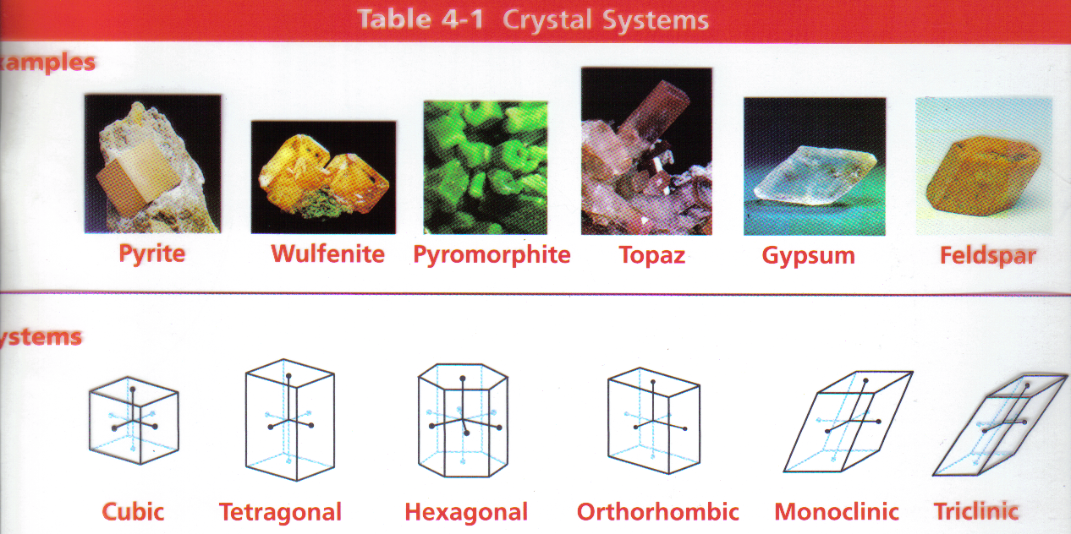
Crystalline Structure
Definite crystalline structure
The atoms in minerals are arranged in regular geometric patterns. (BUT, well-defined shapes are not seen unless they grow slowly in open space)
http://www.bigfoto.com/miscellaneous/photos-16/salt-crystals-94jf.jpg
TT #9 & Table 4-1 p. 78 Crystal Systems
Notes:
WS 4.1
Sec 4.1
Earth’s crust has about 3,000 dif minerals
Calcite in limestone that makes the pyramids, in marble in the Parthenon in Greece
Wars fought over minerals such as gold, silver, and diamonds
What products in our room made from minerals? Graphite, glass
In jewelry, paints, medicines, roads, buildings, etc.
What is a mineral?
Most are compounds
i. Quartz is made from oxygen and silicon, SiO₂
ii. Other minerals can be made form Si & O2 as well, but dif proportions-like H2O & H2O2
iii. Some like olivine can vary in amounts of Fe & Mg, but always in the same ration or percent
6 major crystal systems-see Table 4-1 p 78
Well-defined shapes are not often seen-See Fig 4-2 p 79 Only see if grew in open space w/o restrictions.

Slide 5
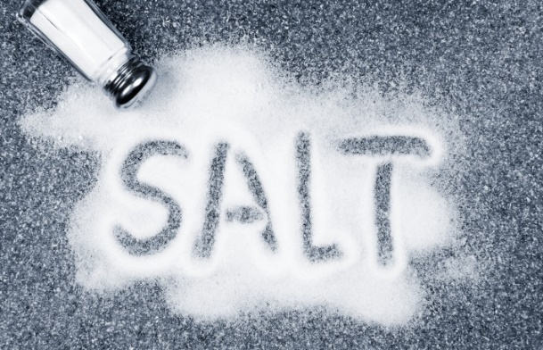
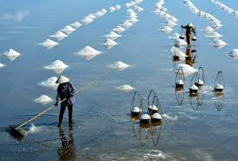
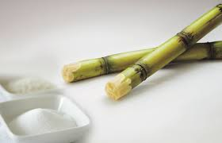
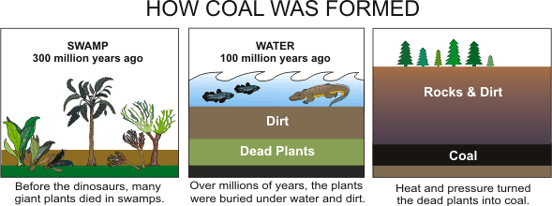
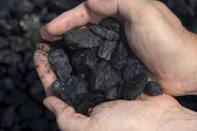
Inorganic or Organic?
Are the following inorganic or organic? Mineral or non-mineral?
Where found or made?
Inorganic
Or
Organic
Mineral
Or
Non-mineral
Ocean
water
http://blog.smartbear.com/devops/a-taste-of-salt-like-puppet-except-it-doesnt-suck/
Salt
Inorganic
Mineral
Sugar
Plants
Organic
NON-mineral
Remains of
living
organisms
http://blog.cazloyd.com/wp-content/uploads/luxury_holidays_vietnam1.jpg
Coal
Organic
NON-mineral
http://www.auroralights.org/userfiles/COALFORMATION.gif
http://www.agricorner.com/wp-content/uploads/2014/04/Sugarcane.jpg
http://quiet-environmentalist.com/wp-content/uploads/2011/02/Dirty-Coal.jpg

Slide 6
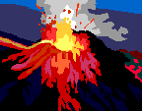
Mineral Formation Occurs from Two Types of Liquids - Magma
Minerals can form from the cooling of magma
Magma is the molten material found beneath Earth’s surface
If the magma has more time to cool the atoms have time to arrange themselves, which results in a larger crystal
Magma cools slowly deep within the earth
If the magma cools off rapidly the crystals will be smaller.
Magma cools rapidly near earth’s surface or when volcano erupts –rapid cooling if contacts air or water
Show granite vs. rhyolite for grain size
Notes:
Cools as rises Why? Surface cooler than core
Slow rise & slow cooling-larger crystals
Fast rise or quick cooling due to contact w/air or water: small crystals
Show granite vs. rhyolite Although is a rock, but made of dif minerals that crystallize in different sizes

Slide 7
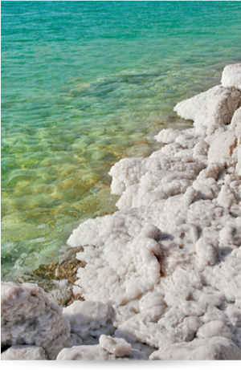
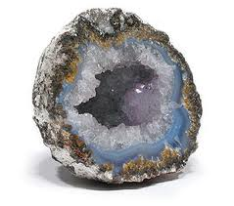
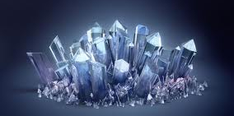
Minerals From Solution
Minerals can also form from a supersaturated solution
A certain amount of water can only dissolve so much of a solid before the water becomes saturated
In nature, if a solution becomes supersaturated, or overfilled, mineral crystals begin to form. (AKA Precipitation = Solid “falls” out of solution)
Evaporation can lead to supersaturated solutions, leaving mineral crystals behind.
This can occur along ocean coastlines and along salt lakes as water level decreases.
http://lib.store.yahoo.net/lib/yhst-128337017012708/adovia-skin-care-dead-sea-salts.jpg
Notes:
Mineral Formation – From Solution
Prior Knowledge:
What is a solution? Salt solution?
What if add little salt? What about a lot? Ever come a time where more won’t dissolve & stay in solution?
What if dissolved, but water evaporates?

Slide 8
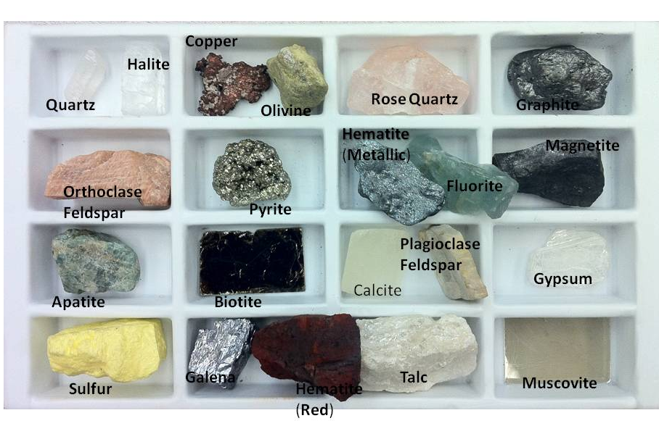
Section 4.2 Mineral Identification Tests Geologists Use
Question of the Day: Now that you’ve developed a means to differentiate minerals, how is it really done?
6 Main Tests to Identify Minerals
Color
Luster
Texture
Streak
Hardness
Cleavage/Fracture

Slide 9
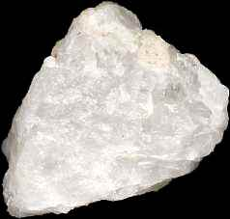
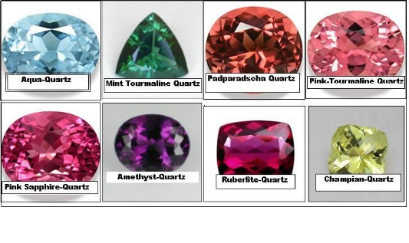
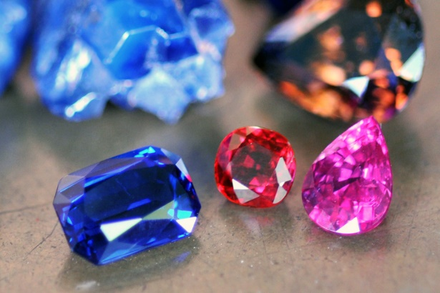
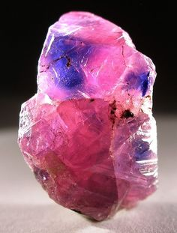
Color
Color
Sometimes varies due to trace elements within an element
Example. Quartz comes in many colors –
Amethyst purple – Iron,
Rose color – Titanium & Manganese
Color is one of the least reliable methods to mineral identity
Both sapphires & rubies are made of corundum: Sapphire blue - Iron & Titanium, Ruby - Chromium
http://www.fieldgemology.org/images/FE15/Sapphire_ruby_zircon.jpg
http://media-cache-ec0.pinimg.com/236x/96/16/55/96165595e5d09542d755406c17dac2b5.jpg
http://www.gemcuttingservice.com/Center-fusedQuartzColorChartA.JPG
Notes:
Color Easy to see, but problems
One of LEAST reliable identification tests Outside can tarnish and react w/air, water, etc. Must be polished or cleaned to see color, and also minor impurities of a trace element can cause a mineral to be different color than expected
Trace elements or compounds can cause color
i. Quartz comes in a variety of color
ii. Red due to iron , rose due to manganese or titanium, milky due to gas bubbles
NOTE: Purple amethyst are a variety of quartz

Slide 10
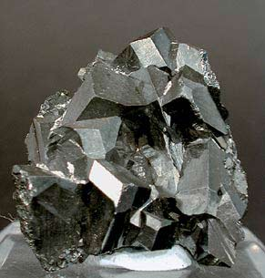
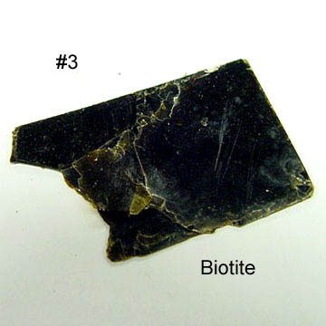
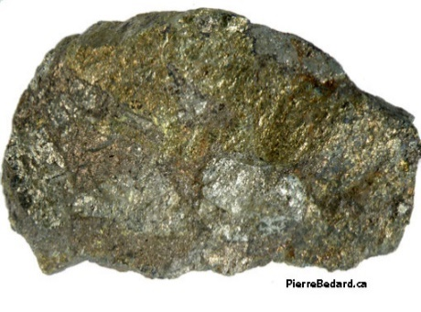
Luster
Luster = the way a mineral reflects light from its surface
Luster is described as metallic or non-metallic.
Metallic example: galena, magnetite, chalcopyrite
Nonmetallic examples: feldspar, quartz, biotite
Differences in luster are caused by differences in chemical composition
http://www.groupes.polymtl.ca/glq1100/mineraux/chalcopyrite/chalcopyrite4.jpg
http://rusoares65.pbworks.com/f/1236545389/BIOTITE.jpg
Notes:
For picture A & B ask about cleavage & fracture

Slide 11
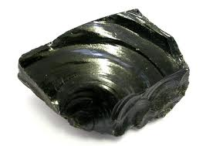
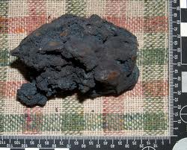
Texture & Streak
Texture = Describes how a mineral feels
The texture might be described as smooth, rough, ragged, greasy, soapy, soft
Streak = The color of a mineral when it is broken up & powdered
A mineral rubbed across an unglazed porcelain plate will sometimes leave a powder streak on the surface
There are times when the streak of a mineral does not match its external color
Streak color is constant, but external color varies due to ­­­­­­­­­­­­­­­­­trace elements
Notes:
Can only be used when the mineral is softer than the porcelain plate So can’t be used to ID all minerals
Examples: pyrite (fool’s gold) is gold in color, but leaves a greenish-black streak, but gold leaves a yellow streak-so one of main tests to tell the too apart.
Fluorite can be externally purple, yellow, green or blue, but streak is always white.

Slide 12
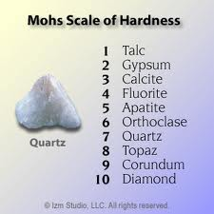
Hardness
Hardness =Measure of how hard a mineral is & how easily it can scratch or be scratched
There is a Moh’s Hardness Scale that is used with this test
Hardness is one the most reliable tests if mineral ID
It is determined by the arrangement of mineral’s atoms
Harder minerals will scratch softer minerals
Softer minerals cannot scratch harder minerals
Minerals are compared to the known hardness of 10 set minerals
#1 is softest (talc)
#10 is hardest (diamond)

Slide 13
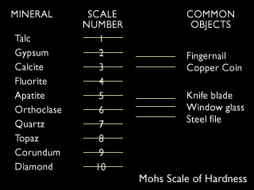

Slide 14
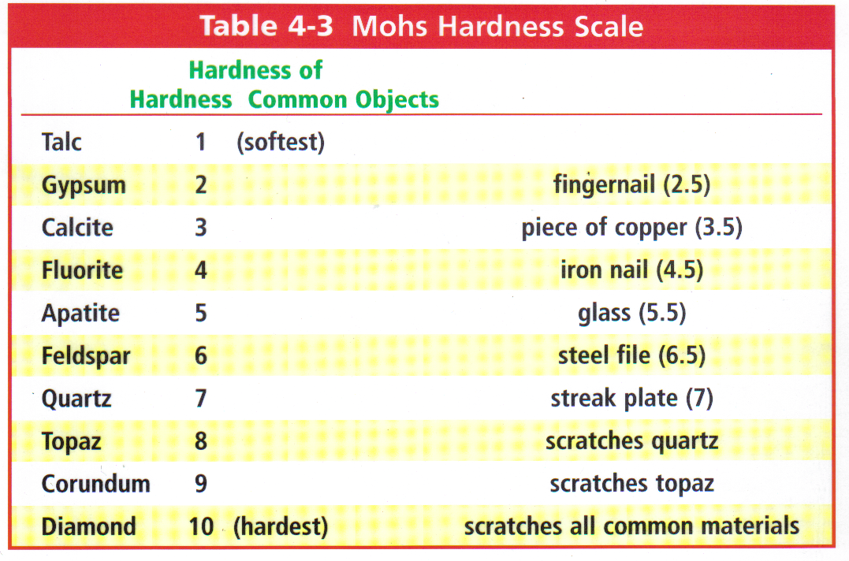
TT #10 or Table 4-3 p 86 Mohs Hardness Scale
Examples using the table. Which will scratch the other?
_____________________ vs. _____________________
_____________________ vs. _____________________
_____________________ vs. _____________________

Slide 15
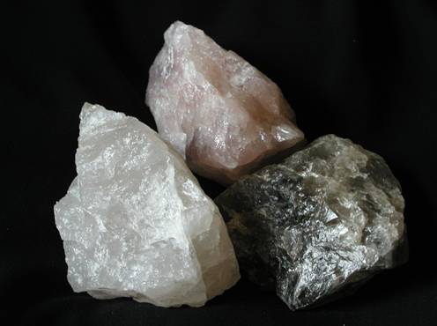
Cleavage and Fracture
6. Cleavage/Fracture = Describes how a mineral breaks
Atomic arrangements also determine how a mineral will break
Minerals break where atomic bonding is weak
A mineral that splits relatively easily and evenly along one or more flat planes to have cleavage
Minerals that break in rough or jagged edges are said to have fracture (Fracture – like crumpled paper & then spread out – looks wrinkled w/o even small flat areas)
Notes:
Cleavage & Fracture
What does it mean if glass is fractured? Clean break? Many pieces? Irregular? Vs. just broken?
Determined by atomic arrangement
Break along planes where bonding is weak
Cleavage: Breaks along 1 or more flat planes with set angles
Fracture: Break with rough & jagged edges Tightly bonded atoms that don’t break easily
i. Conchoidal fracture: arc like pattern like a clam shell
Fig 4-11 p87

Slide 16
Diagram – Cleavage in Multiple Directions
http://academic.brooklyn.cuny.edu/geology/grocha/mineral/images/cleavage.jpg

Slide 17
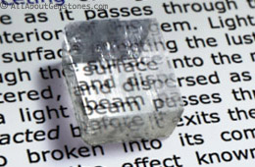
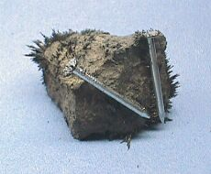
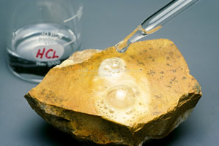
Special Properties
Special Properties unique to a specific mineral can sometimes be helpful in identification.
Calcite:
Double refraction: Mineral bends light, causing a double image.
Fizzes and is dissolved by acid. (Acid rain can dissolves calcite & form caves.) Reaction releases CO₂
Magnetite is magnetic
http://www.allaboutgemstones.com/images/gem_birefringence_double_refraction_calcite.jpg
http://www.minerals.net/images/lodestone-magnetite-magnetic.jpg
http://www.dinojim.com/Geology/GeoBasics/Images/ReactstoAcid.jpg

Slide 18
Mineral Groups/Classification
Based on observations of the table below, make an inference about what determines which group a mineral belongs in. Explain.
http://www.oncoursesystems.com/images/user/8552/388319/Minerals/commin.jpg

Slide 19
Silicates
The chart contains minerals of the Silicate Mineral Group.
Examine the chart:
Elements in all silicates: What symbols (elements) are present in ALL of the formulas?
Dark Colors: What symbols are present in the DARK colored silicates but not usually in the light colored silicates?
http://geophysics.ou.edu/geol1114/notes/minerals/silicate_structures3.jpg
Notes:
Mineral Groups
Prior Knowledge: Most common elements in Earth’s crust? If don’t know-look at Fig 4-4 p 81
3000 minerals, but only 30 of them are common
Common ones called rock-forming minerals because make up most of the rocks in Earth’s crust
How many elements on Periodic table?
Remember where man-made ones are?
So only about 90 elements occur naturally in the crust.
Of those 90, minerals usually made of the 8 most common elements
Silicates-made of silicon, oxygen, and usually 1 or more other elements
Most common mineral, 96% of the minerals in the crust
Examples: feldspar & quartz
Show minerals
Tetrahedron shape: 1 silicon in center of 4 oxygen atoms
i. See Fig 4-5 p81
ii. Unique structure allows recombination in number of ways, p82
iii. Structure causes differences when the mineral splits
Show atom model tetrahedral shape
Show planar cleavage/breakage of mica vs. quartz which doesn’t break easily along planes

Slide 20
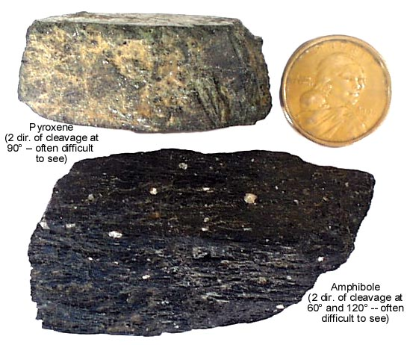
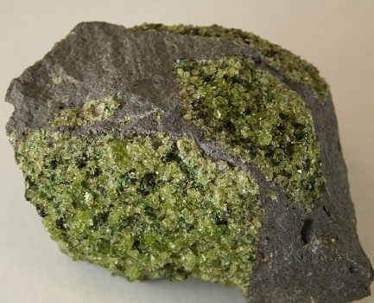
Silicates & Dark Colored Silicates
Silicates - Made of silicon, oxygen and usually 1 or more other elements
Silicates are the most common mineral , 96% of the minerals in the crust
DARK-COLORED Silicates
Lower amount of oxygen & silicon
High amount of iron & magnesium which cause dark color.
Called Ferromagnesian silicates. Why? Fe = Iron Mg = Magnesium
Examples of dark silicates HIGH in Fe and/or Mg:
Olivene
Pyroxene
Amphibole
Biotite
http://www.geo-logic.org/images/Minerology/olivine-windows2universe.org.jpg
http://gsi.ir/Images/Training/BIOTITE.jpg
http://itc.gsw.edu/faculty/bcarter/physgeol/min/femag.jpg
Notes:
Mineral Groups
Prior Knowledge: Most common elements in Earth’s crust? If don’t know-look at Fig 4-4 p 81
3000 minerals, but only 30 of them are common
Common ones called rock-forming minerals because make up most of the rocks in Earth’s crust
How many elements on Periodic table?
Remember where man-made ones are?
So only about 90 elements occur naturally in the crust.
Of those 90, minerals usually made of the 8 most common elements
Silicates-made of silicon, oxygen, and usually 1 or more other elements
Most common mineral, 96% of the minerals in the crust
Examples: feldspar & quartz
Show minerals
Tetrahedron shape: 1 silicon in center of 4 oxygen atoms
i. See Fig 4-5 p81
ii. Unique structure allows recombination in number of ways, p82
iii. Structure causes differences when the mineral splits
Show atom model tetrahedral shape
Show planar cleavage/breakage of mica vs. quartz which doesn’t break easily along planes

Slide 21
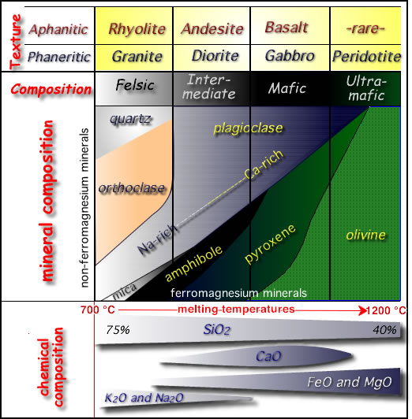
Diagram – Chemical Composition of Silicates
NOTE: Mineral colors & names
Chemical % composition that correlates with those colors
Preview names of rocks at top of table: minerals combine to make rocks.
Rocks will be light or dark based on the percent of light & dark minerals in them
http://w3.salemstate.edu/~lhanson/gls100/image1/igneous_classification3.jpg

Slide 22
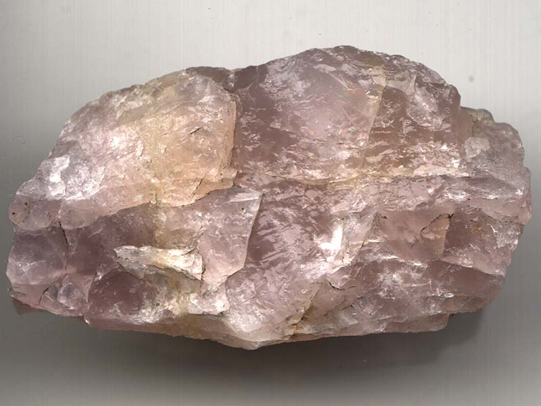
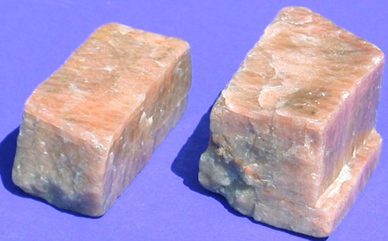
Light Colored Silicates
LIGHT-COLORED Silicates
Highest amount of Silicon (Si) & Oxygen (O)
High amount of Potassium (K) & Sodium (Na)
Called NON - Ferromagnesian silicates. Why? _________________________
Examples of LIGHT-colored Silicates: Quartz & Feldspar
http://www.pitt.edu/~cejones/GeoImages/1Minerals/1IgneousMineralz/Feldspars/FeldsparCleavages.jpg
Notes:
Mineral Groups
Prior Knowledge: Most common elements in Earth’s crust? If don’t know-look at Fig 4-4 p 81
3000 minerals, but only 30 of them are common
Common ones called rock-forming minerals because make up most of the rocks in Earth’s crust
How many elements on Periodic table?
Remember where man-made ones are?
So only about 90 elements occur naturally in the crust.
Of those 90, minerals usually made of the 8 most common elements
Silicates-made of silicon, oxygen, and usually 1 or more other elements
Most common mineral, 96% of the minerals in the crust
Examples: feldspar & quartz
Show minerals
Tetrahedron shape: 1 silicon in center of 4 oxygen atoms
i. See Fig 4-5 p81
ii. Unique structure allows recombination in number of ways, p82
iii. Structure causes differences when the mineral splits
Show atom model tetrahedral shape
Show planar cleavage/breakage of mica vs. quartz which doesn’t break easily along planes

Slide 23
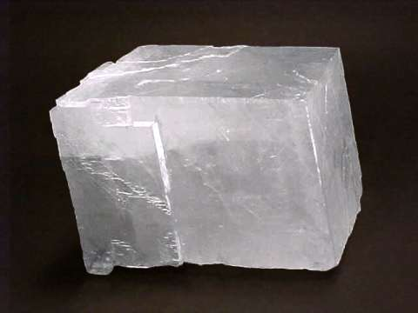
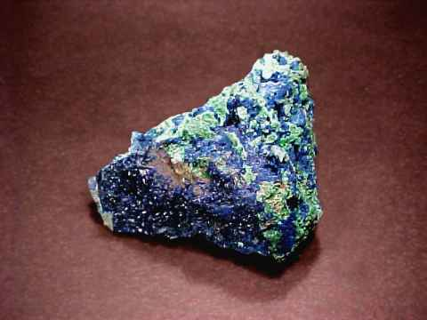
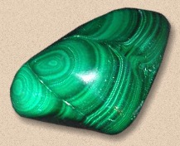
Carbonates
Carbonates: made of Carbon (C) and oxygen and a metal
Example: Calcite
Carbonate = CO₃
In rocks such as limestone & marble
There are some carbonates that have distinctive colorations.
Fig 4-7 p. 83
Calcite Azurite Malachite

Slide 24
Fig 4-4 p. 81 Elements in Earth’s Crust
NOTE: 8 elements combined make up 98.5% of Earth’s crust, and they are the main elements in the minerals we’ve discussed.

Slide 25
Review & Test Prep
Streak vs. color – which is most reliable?
Types of luster?
Show examples
5 characteristics common to all minerals?
5 tests to identify minerals?
Moh’s scale
Scale of what?
Example questions on next slide
Test overview
Review & discuss objectives. Suggest writing outline or flash cards based on the objectives as a means to study.
Notes:
Moh’s – scale of hardness, NOT density

Slide 26
Review: Table 4-3 p 86 Mohs Hardness Scale
What does it tell you if a mineral scratches glass?
Fluorite vs. topaz
What happens if mineral with hardness of 3.5 is rubbed against: Feldspar? Calcite?
A mineral scratches gypsum, but not apatite:
What is its hardness range?
How could you further determine its hardness?

