Slide 1
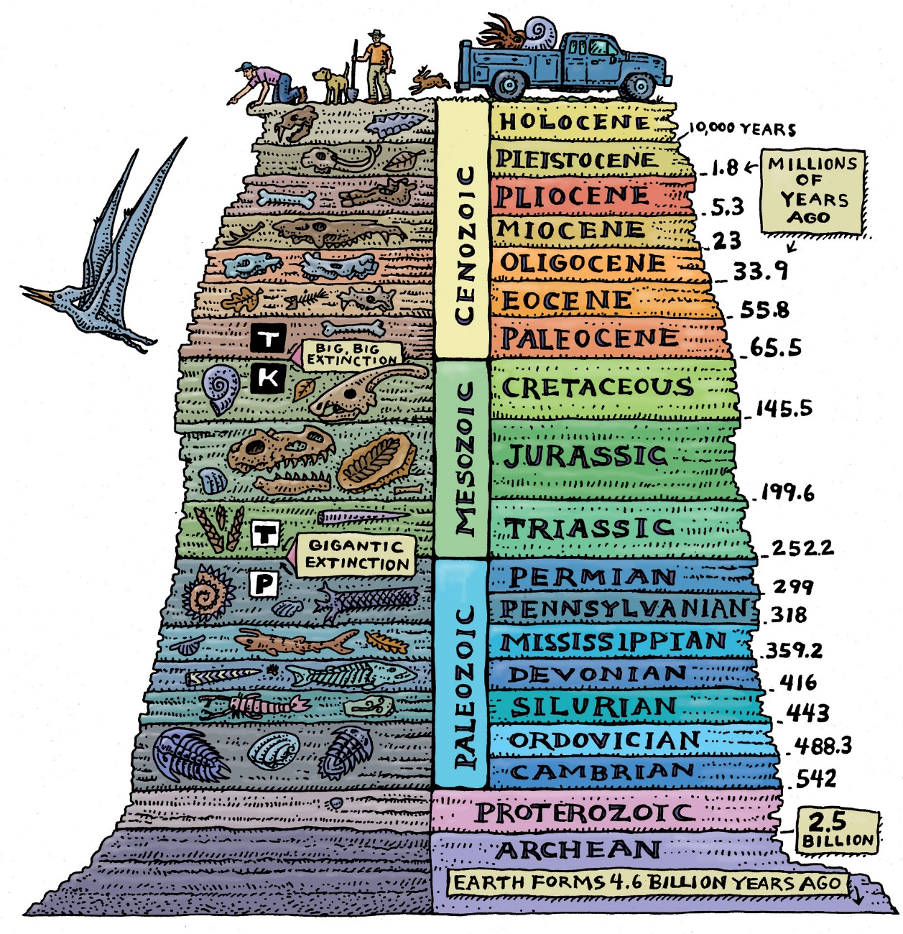
Geologic Time: Fossils & the Rock Record
Chapter 21
http://greenforecast.com/wp-content/uploads/2013/04/geologic-time-drawing.jpg

Slide 2
Objectives: Geologic Time Scale
I understand how Earth’s history is divided into sections of time called the geologic time scale. This means I can:
Explain how major changes mark the boundaries between the sections.
Discuss the general changes in organisms from the appearance of life on Earth to present day.

Slide 3
Objectives: Fossils
I can describe the characteristics of Index Fossils and explain how Index Fossils are used.
Discuss how fossils can be used to interpret Earth’s past physical and environmental history.

Slide 4
Objectives: Dating of Rocks
I can apply the principles for determining relative age to interpret rock sequences. This means I can:
Determine the oldest and youngest layers using the Law of Superposition.
Determine the relative age of layers and intrusions
Match rock layers in different areas using Correlation.
I can apply the principles for determining absolute age using radioactive decay rates and half-life(s).
I can discuss the differences in the radioactive decay of different elements. This means…
I can describe when to use Carbon-14 vs Uranium-238.
I can describe limitations of Carbon-14 and Uranium-238 when dating objects.

Slide 5
Rock layers can be seen on this exposed cliff. Each layer represents a certain span of time.
What techniques can scientists use to estimate the age of the rock?

Slide 6
TWO Types of Dating of Rocks
Section 21.2 & 21.3
How scientists study Earth’s history

Slide 7
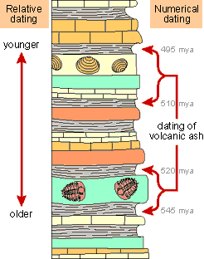
Two Types of Dating
Absolute Dating determines the actual NUMERICAL age in years
Relative Dating simply classifies rocks or fossils as older or younger

Slide 8
Absolute -Age Dating of Rocks
Section 21.3
How scientists study Earth’s history

Slide 9
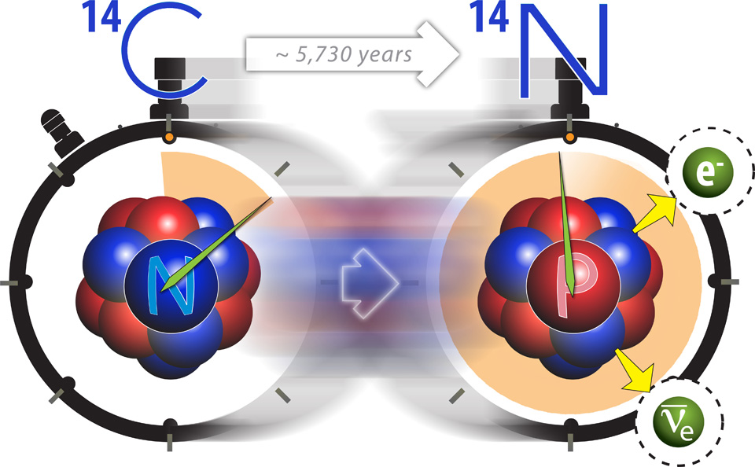
Radioactive Decay
Review: Absolute Dating determines the actual NUMERICAL age in years
Radioactive decay of elements is used to determine the absolute age of rocks
Radioactive elements decay into a new element
Example: Carbon changes into nitrogen

Slide 10
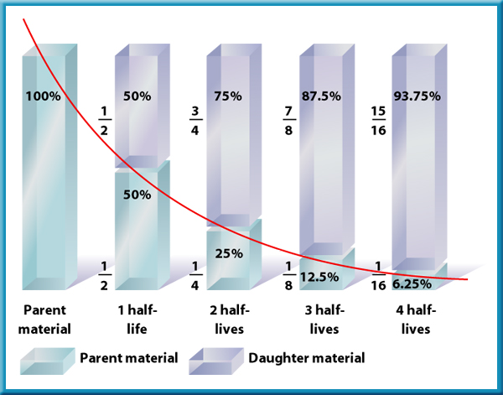
Half-Life
The half-life of an element is the time it takes for half (50%) of the atoms in the element to decay into a new element.
By measuring the percent of original element left, absolute age can be determined.

Slide 11
Your Turn: Half-Life Determination from Graph
What is the half-life of the element in the graph below?

Slide 12
Answer:
Half-Life Determination from Graph
****Additional Half-Life Problems at End of Note Packet

Slide 13
Review of Computer Simulations What Radioactive Elements can be used for Dating?
 | Carbon-14 | Uranium
What is it’s half life?
What objects can it date?
What are it’s limitations? (When can it NOT be used?)

Slide 14
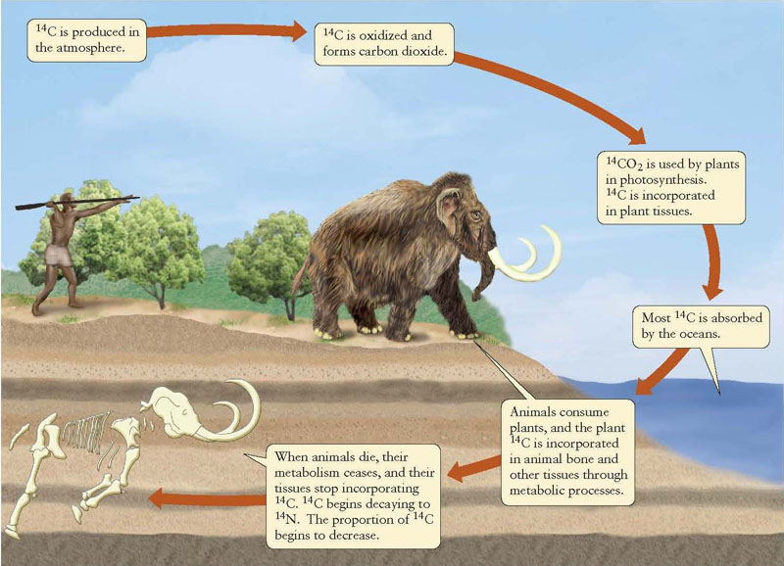
Radiometric Dating of Fossils
0
Figure 2.5A
Figure 2.5B
Notes:
Radioactive elements are also used in diagnostic medical procedures. The release of the radioactive decay is monitored by sophisticated instruments and assists in the diagnosis of diseases such as cancer and kidney failure. Radiation can also be used as a treatment. (Cancer patients receive radiation to kill the cancer cells, and hyperthyroid patients receive radioactive iodine to reduce the activity of the thyroid gland.)
Medical Diagnosis
Radioactive tracers used for diagnosis, through sophisticated imaging instruments such as PET scans
“Hot spot” below is area of throat cancer

Slide 15
Carbon Dating
C-14 is used to date once-living remains
During life, animal breathes in CO2 and eats carbon in foods
After death, no more C-14 is taken in.
Age of a fossil is calculated by how much C-14 is left.
Older fossils have:
Less C-14
More Nitrogen (What C-14 turns into)
Can only be used on FOSSILS, less than 50,000 years old

Slide 16
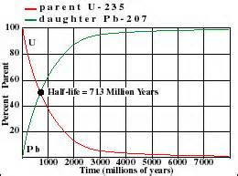
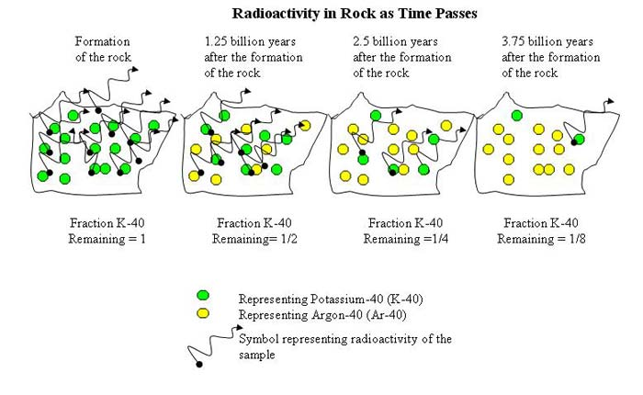
Other Radioactive Elements
Other elements used to date ROCKS include:
Uranium-238 (U-238)
Half-life = 4.5 Billion Years
Used on ROCKS over 10 million years old
Uranium changes to Lead
Uranium-235 (U-235) Half-life = 0.7 Billion Years
Potassium-40 (K-40) Half-life = 1.25 Billion Years

Slide 17
Uranium-238 Calculations
Uranium-238 Half-life = 4.5 Billion Years
 | Percentage of Uranium-238 | Percentage of Lead | Age (billions of years)
Initial Value
After one half-life
After two half-lives
After three half-lives
After four half-lives

Slide 18
Uranium-238 Calculations
Uranium-238 Half-life = 4.5 Billion Years
 | Percentage of Uranium-238 | Percentage of Lead | Age (billions of years)
Initial Value | 100.00% | 0.00% | 0
After one half-life | 50.00% | 50.00% | 4.5
After two half-lives | 25.00% | 75.00% | 9.0
After three half-lives | 12.50% | 87.50% | 13.5
After four half-lives | 6.25% | 93.75% | 18.0

Slide 19
Relative-Age Dating of Rocks
Section 21.2
How scientists study Earth’s history

Slide 20
Ways to Determine Relative Age
Law of Superposition can be used in rock that is not disturbed (moved around by tectonic forces)
Older rocks on bottom.
Younger rocks on top.

Slide 21
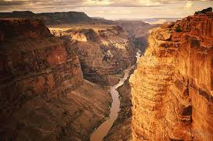
Ways to Determine Relative Age
Uniformitarianism = Theory that states the processes happening on Earth today have been occurring since Earth began. 2 types of processes:
Slow everyday processes
take thousands of years to change the land
Erosion, deposition, etc
Violent & sudden events
change the land instantly:
earthquakes, asteroid collision, etc.

Slide 22
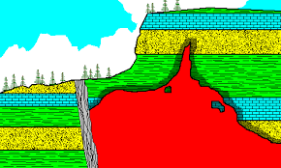
3. Exceptions to Law of Superposition
Earthquakes, volcanism, flooding, weathering & erosion:
Disturb the rock layers
Make it difficult to use the Law of Superposition
Intrusion: Magma that flows into cracks of existing rocks and cools into igneous rock:
Intrusions are always younger than the layers they pass through

Slide 23
Faults cause layers to shift up or down

Slide 24
Intrusions must be younger than the rock they pass through.
You cannot go
through something unless it was there
first!

Slide 25
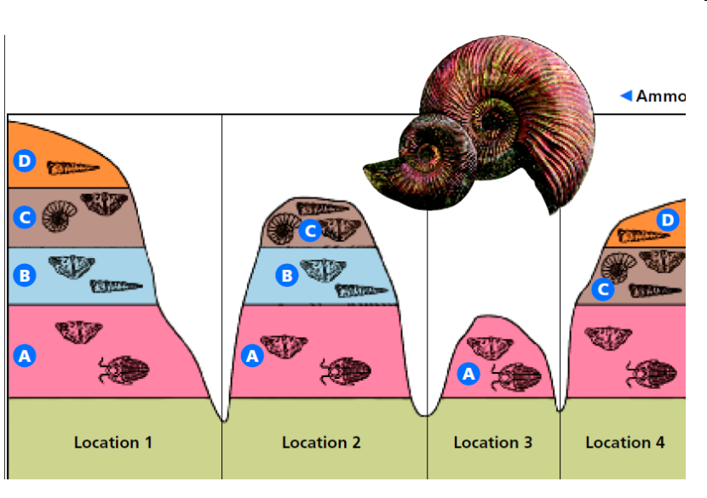
Erosion can cause layers to disappear.

Slide 26
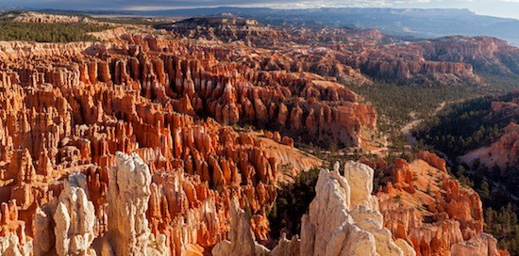
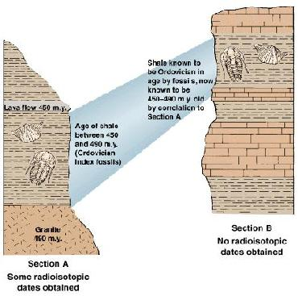
4. Distinctive Sediment Layers
Correlation is matching rock layers from one location to another by matching index fossils and/special layers. Examples:
Sandstone containing oil, ammonite fossils
Grand Canyon (Arizona), Zion (Utah), Bryce (Utah)
http://lc3.littlechute.k12.wi.us/staff/cchoudoir/Class%20Website/Geologic%20Time/RD%20Reading_files/image020.jpg
https://fc.wellesley.k12.ma.us/~Rita_Chang/FOV1-0001E023/FOV1-0002867C/correlation.jpg

Slide 27
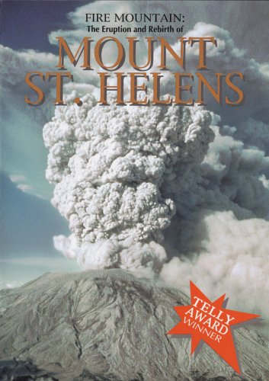
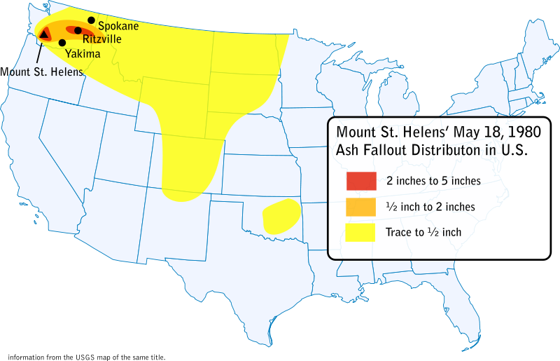
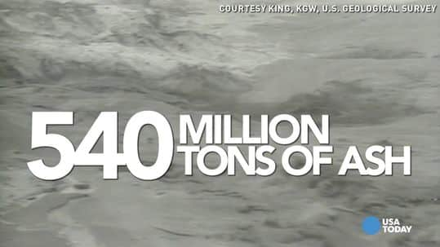
Distinctive Sediment Layers Continued
Short-lived events such as asteroid impact or massive volcanic eruption form DISTINCTIVE layers used to determine relative age
Examples:
Mount St. Helen’s 1980 – ash over several states makes a layer known to have been made in 1980
Asteroid impact at the boundary of the Mesozoic and Cenozoic time periods left a layer of space material.
Layer is age of the dinosaur extinction

Slide 28
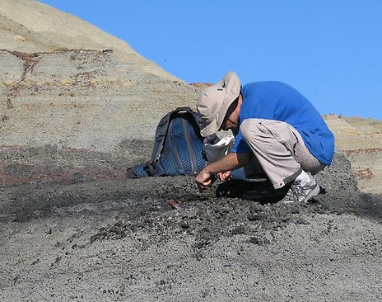
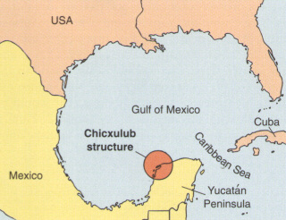
Iridium – Evidence of Asteroid Yucatan
http://www.sciencemag.org/content/327/5970/1214/F2.large.jpg

Slide 29
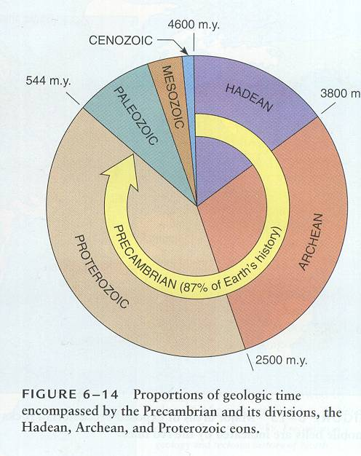
Measuring Time
According to current theories, the Earth has existed for 4.6 billion years

Slide 30
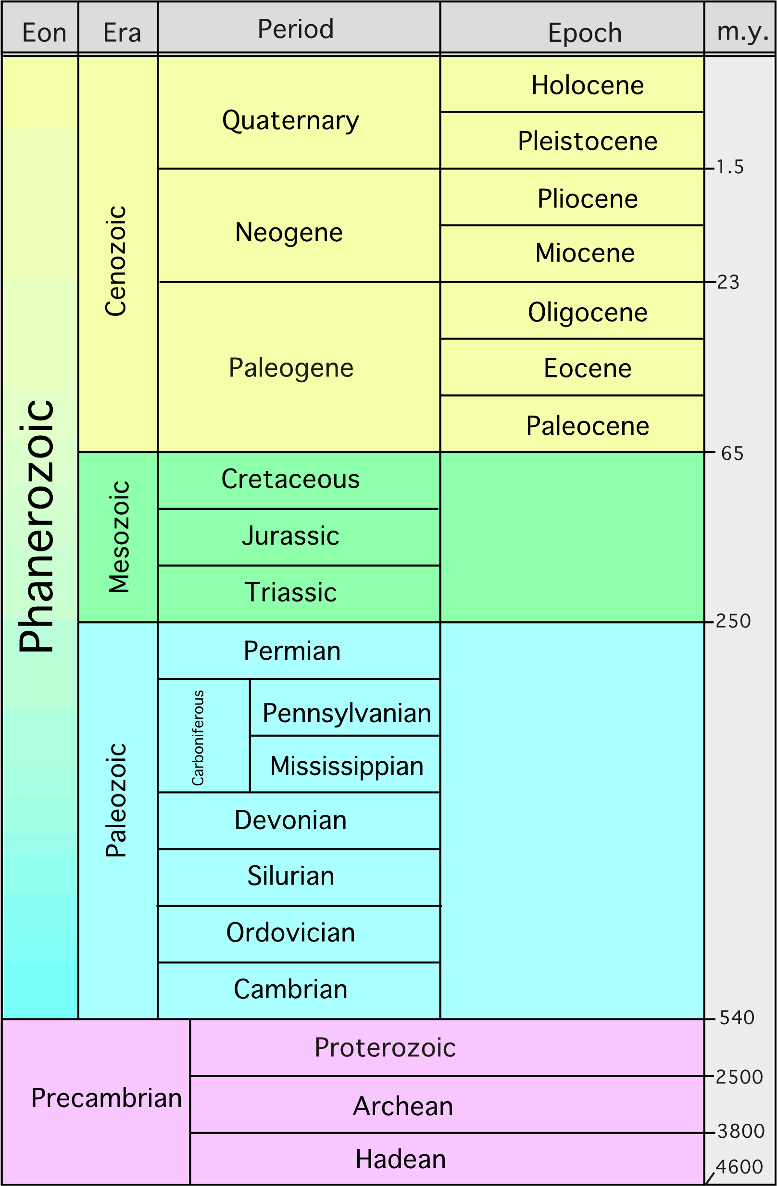
What Units of Time are Used to Measure Earth’s History??
The 4 Main Units:
Eon: Largest amount of time
Era
Period
Epoch: Smallest amount of time

Slide 31
What Units of Time are Used to Measure Earth’s History??
How Are They Listed?
Recent at top
Oldest listed at bottom

Slide 32
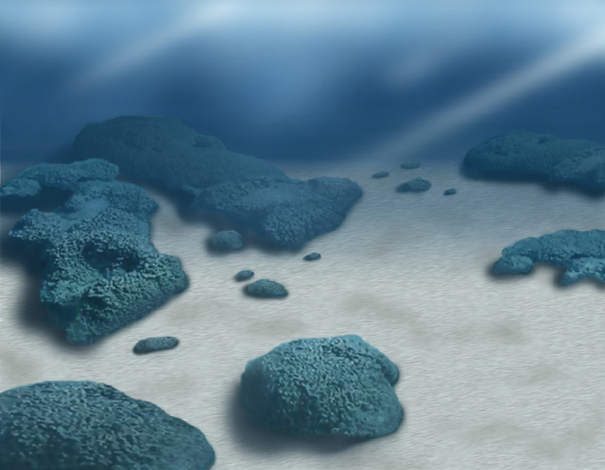
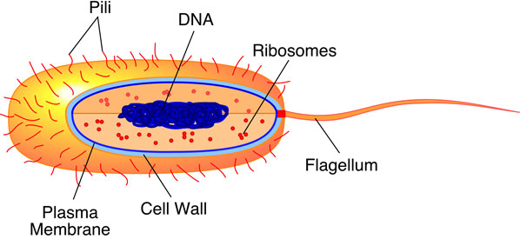
Precambrian Time
Began with the formation of the Earth (4.6 billion years ago)
At first, there was no oxygen or living things
The first organisms appeared in the oceans 3.6 billion years ago
They were single-celled bacteria

Slide 33
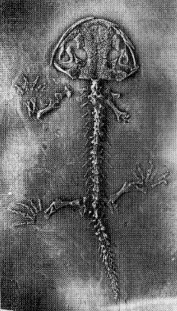
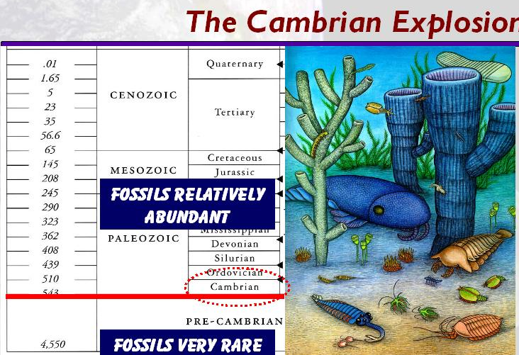
Cambrian Explosion – Beginning of Paleozoic Era
The CAMBRIAN EXPLOSION marks the boundary between Precambrian Time & Paleozoic Era.
MANY new and complex life forms appeared
Organisms had hard parts (shells, exoskeletons) which left many more fossils

Slide 34
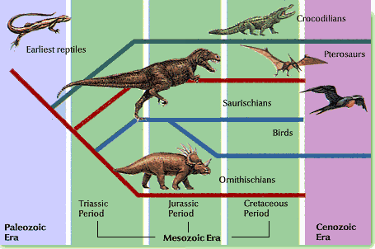
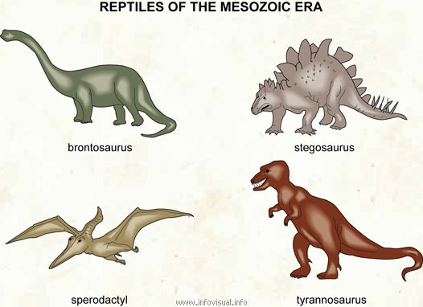
Beginning of Mesozoic Era
Many ocean animals became extinct at the boundary between the Paleozoic & Mesozoic Eras.
Dinosaurs appear
Mesozoic Era is know as the “Age of Reptiles”

Slide 35
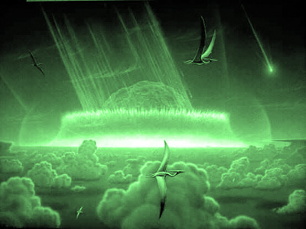
End of Mesozoic Era
All dinosaurs and many animals & plants went extinct
Theory:
Scientists think an asteroid hit Earth
Dust clouds blocked the sun, causing plants to die, then herbivores, then carnivores.

Slide 36
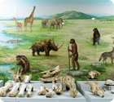
Cenozoic Era
Current era – the one we are living in
AKA: Age of mammals.
Humans appear.
We know the most
about this era because
the fossils are in the
top layers and are
easier to find

Slide 37
Why do we switch eras?
Using the information on pages 4-6 of your notes, work with your group and create an inference on how time is divided.

Slide 38
Class Discussion: What are the Actual Reasons There Are Era Switches?

Slide 39
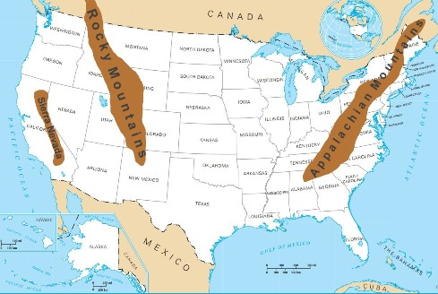
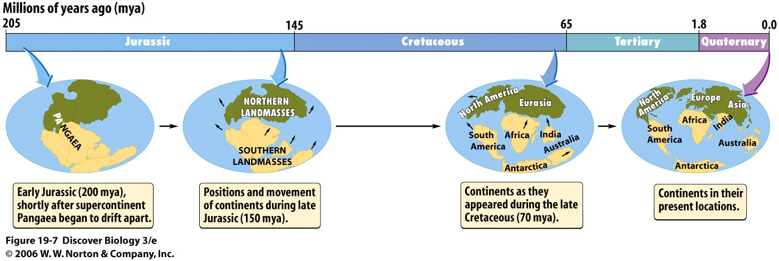
How Are Smaller Periods & Epochs Divided?
Smaller divisions of time (Periods & Epochs) are based on changes in life forms AND land formation. Examples:
North America is covered by shallow seas
Pangea breaks up
Rocky Mountains form
Grand Canyon forms

Slide 40
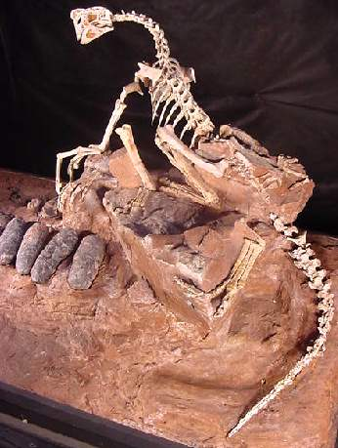
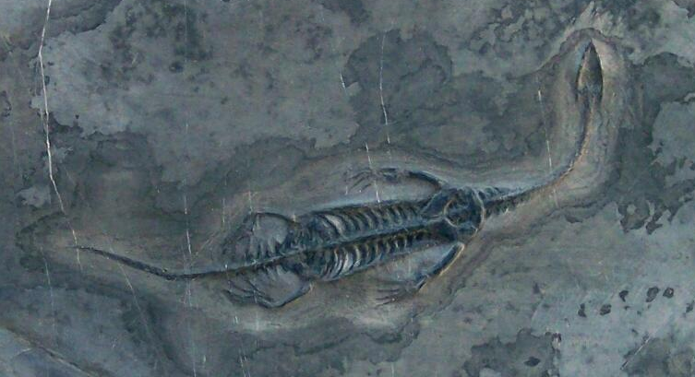
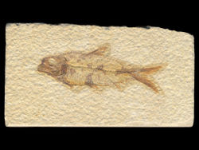
Remains of Organisms in Rock Record Section 21.4
Fossil = Remains or evidence of a once-living plant or animal
Fossils help scientists approximate:
When life began
Types of animals and plants
Extinction of species
Most organisms decay and don’t become fossils

Slide 41
Remains of Organisms in Rock Record Section 21.4
Fossils are more likely to form if:
Quick burial occurs.
Protects the fossil from being eaten by predators
Prevents it from being weathered.
Organism has hard body parts (bones, teeth, shells)

Slide 42
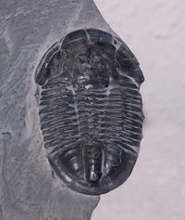
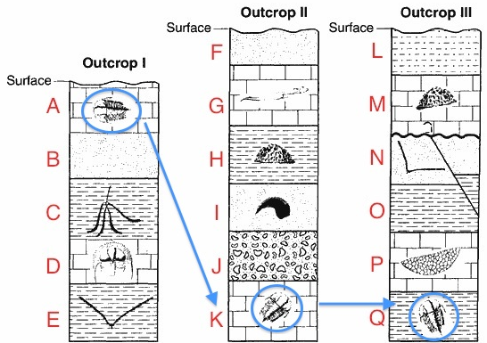
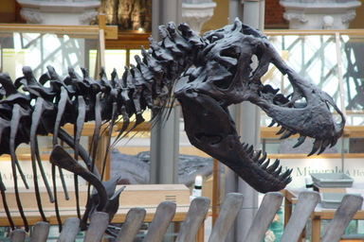
Index Fossils
Index Fossils = Fossils used to match rock layers or to determine the age of a rock layer.
Characteristics needed to be an Index Fossil:
Easily recognized
Widespread
Lived during a short time
Examples: Trilobites, dinosaurs

Slide 43
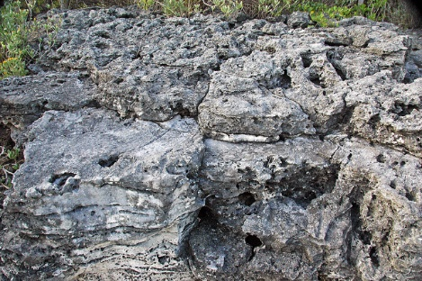
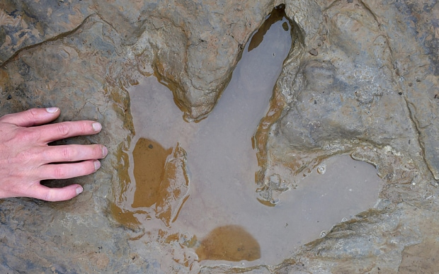
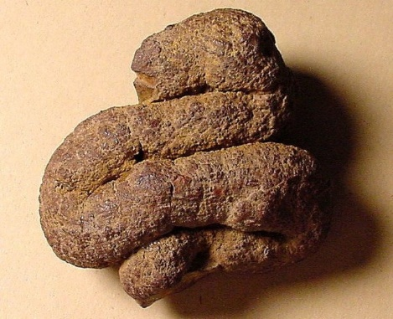
Trace Fossils
Trace Fossils = INDIRECT evidence of the activity of life.
Examples include:
Fossilized tracks
Trails and burrows
Fossilized dung (coprolites) – can help scientists learn about eating habits of ancient animals

Slide 44
Who’s On First Layers

Slide 45
Half-Life Problem #1
We start with 40 grams of Ra-226
Ra-226 has a half-life of 1620 years
How much is left after 8100 years?
½ life period | % original remaining | Time Elapsed | Amount left
0 | 100 | 0 | 40 grams
1 | 50 | 1620 yrs | 20 grams
2 | 25 | 3240 | ?
3 | 12.5 | 4860 | ?
4 | 6.25 | 6480 | ?
5 | 3.125 | 8100 | ?
10 grams
5 grams
2.5 grams
1.25 grams

Slide 46
Half-Life Problem #2:
A sample of Iodine-131 had an original mass of 16g.
How much will remain in 24 days if the half life is 8 days?
Grams: 16g 8 4 2g
Half lives 0 1 2 3
Time elapsed (days) 0 8 16 24

Slide 47
Percentages: Initial
Blue = C¹⁴. Red = N¹⁴. C-14 half-life = 5,730 years
At the beginning, it is 100% parent element, 100% C-14.
How much is there after each half-life? How many years have passed?
Half lives | % C¹⁴ | %N¹⁴ | Age In Years
0 | 100% | 0% | 0

Slide 48
Percentages: 1 Half-Life
Blue = C¹⁴. Red = N¹⁴. C-14 half-life = 5,730 years
Half lives | % C¹⁴ | %N¹⁴ | Age In Years
0 | 100% | 0% | 0
1 | 50% | 50% | 5,730

Slide 49
Percentages: 2 Half-Lives
Blue = C¹⁴. Red = N¹⁴. C-14 half-life = 5,730 years
Half lives | % C¹⁴ | %N¹⁴ | Age In Years
0 | 100% | 0% | 0
1 | 50% | 50% | 5,730
2 | 25% | 75% | 11,460

Slide 50
Percentages: 3 Half-Lives
Blue = C¹⁴. Red = N¹⁴. C-14 half-life = 5,730 years
Half lives | % C¹⁴ | %N¹⁴ | Age In Years
0 | 100% | 0% | 0
1 | 50% | 50% | 5,730
2 | 25% | 75% | 11,460
3 | 12.5% | 87.5% | 17,190

Slide 51
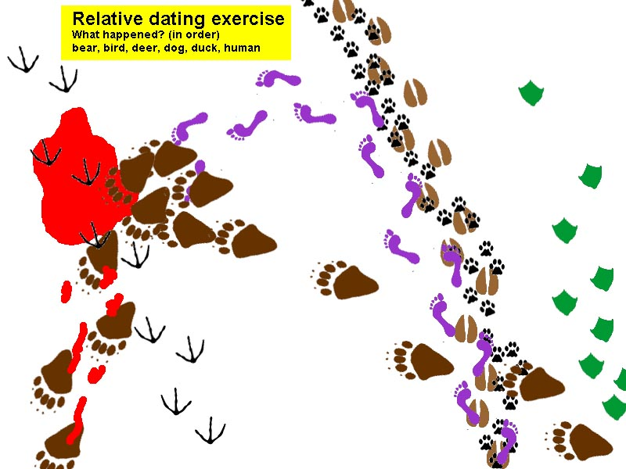
Mini-Activity Relative Dating with Footprints
http://www.geologycafe.com/images/relative_dating.jpg

Slide 52
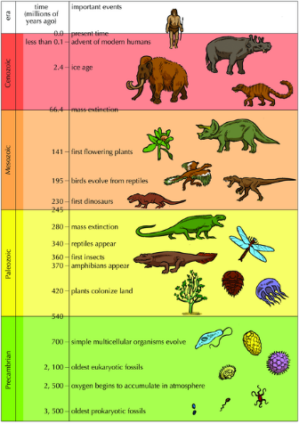
How is Time Divided?
Major changes in Earth’s history mark the boundaries between the time divisions.
Most eras were divided because a major organism appeared or went extinct. Examples:
Boundary between Paleozoic & Mesozoic Eras: Many ocean animals become extinct & dinosaurs appear
Boundary between Mesozoic Eras & Cenozoic Eras: Dinosaurs become extinct & mammals become abundant

